Slide 1
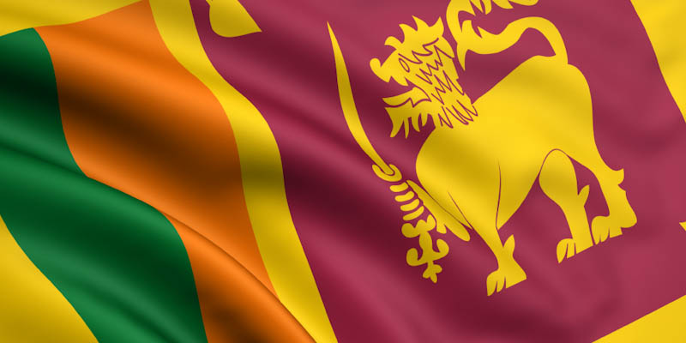
BUSINESS OPPORTUNITIES IN SRI LANKA
5 April 2012

Slide 2
THE END OF WAR
2009 - end of three decade conflict
Best performing stock market 2010
2nd highest economic growth in Asia 2011 – ADB
Favorable environment to capitalize on peace dividend

Slide 3
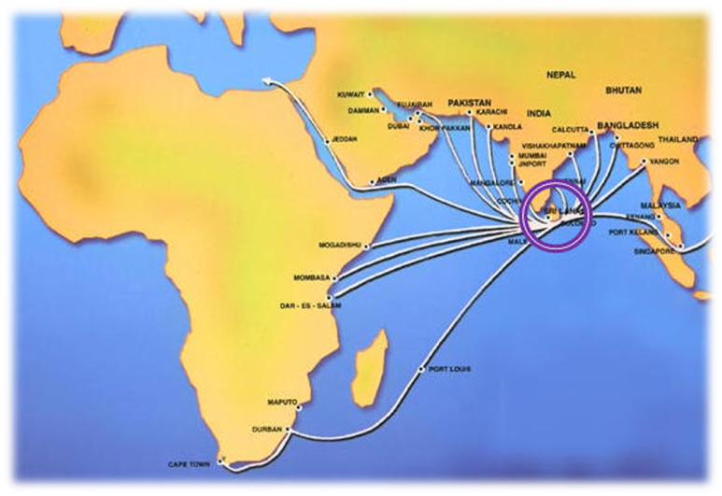
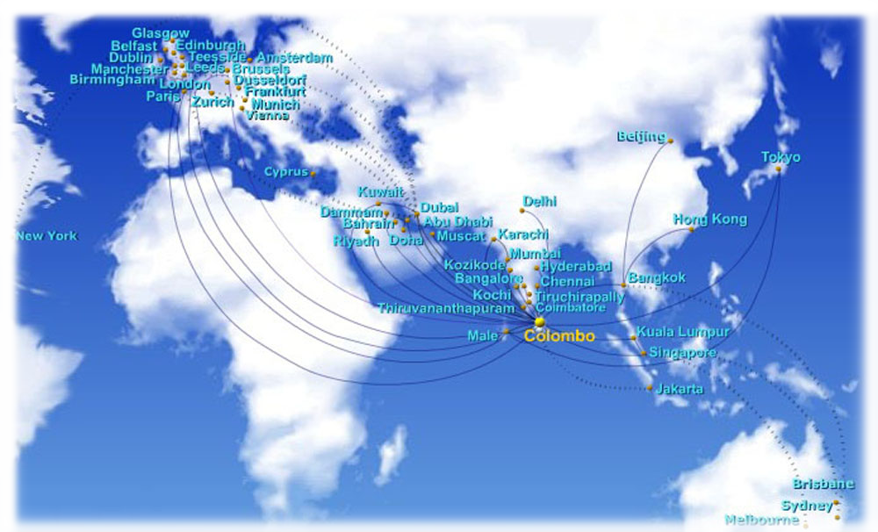
THE ISLAND
A distinct island below the southern tip of India
65,000 sq. km with 1,330 km of coastline
Population of 20 million
Geographic hub well positioned connecting East and West

Slide 4
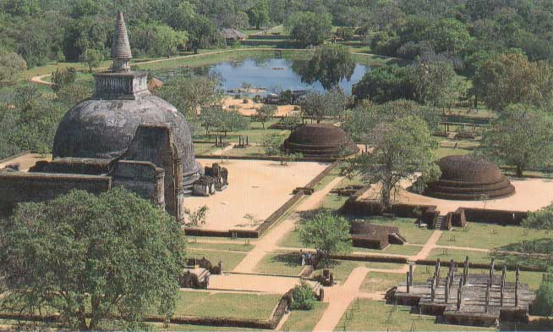
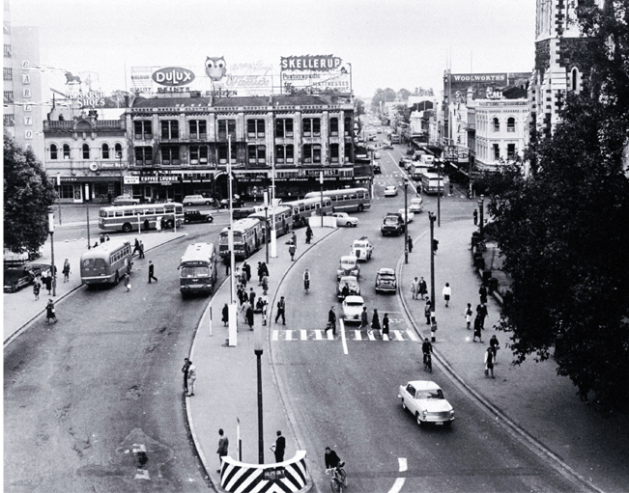
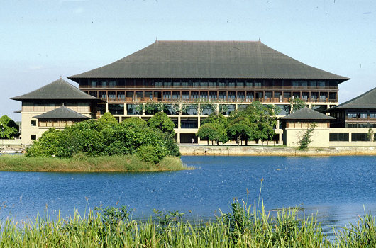
HISTORY & POLITICS
History dating back to 1500 BC
1505 – 1948 - Portuguese, Dutch and British rule
1948 Independence
Democratic Government
Executive President
Parliament of 225 members
Sound legal system & Independent judiciary
Open economy since 1977

Slide 5
OVERSEAS REALTY (CEYLON) PLC
Overseas Trust Bank (Hong Kong) established Overseas Realty (Ceylon) Limited in 1982
Shing Kwan Group of Singapore took over Overseas Realty in 1990
Listed on the Colombo Stock Exchange
Largest Property Development Company
Real Estate Investments:
World Trade Center, Colombo
Havelock City Project

Slide 6
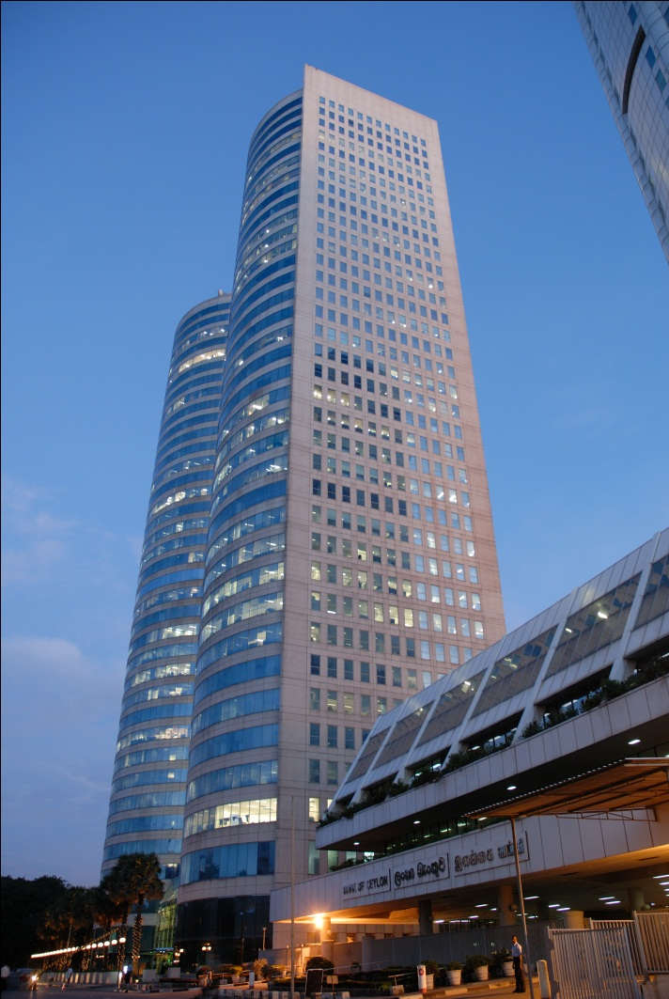
World Trade Center Colombo “Best Business Address in Sri Lanka”
Developed in 1997
2 towers of 39 stories
700,000 sq. ft. of rentable space
1.1 million sq.ft. built up area
Only ‘Intelligent’ building in the Country
One stop business center
Largest B2B network under one roof
Most energy efficient building
Colombo Stock Exchange, the Board of
Investment, Securities & Exchange
Commission along with several local &
international banks are located at WTC

Slide 7
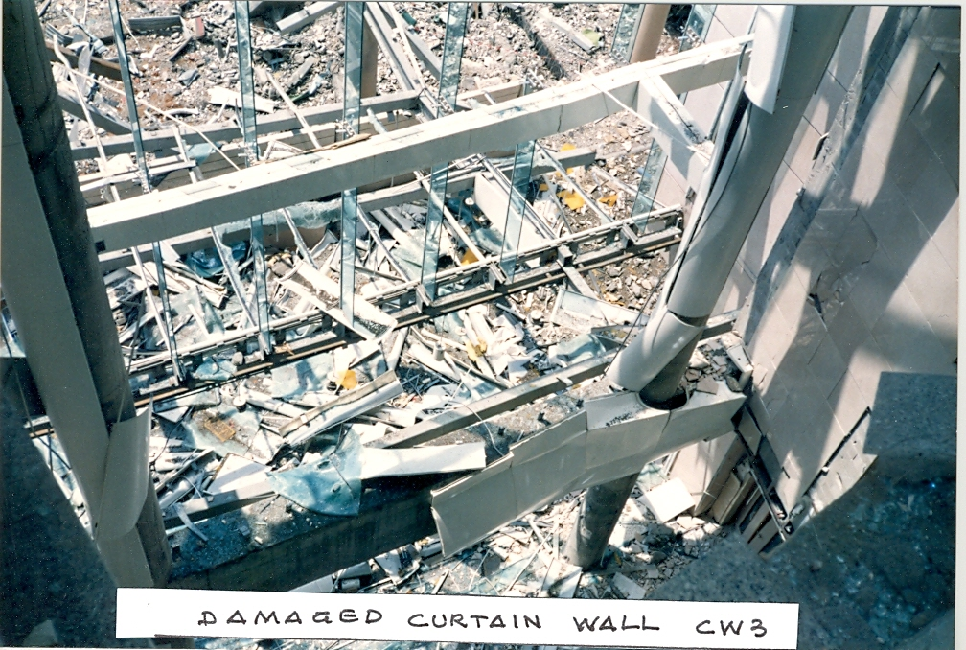
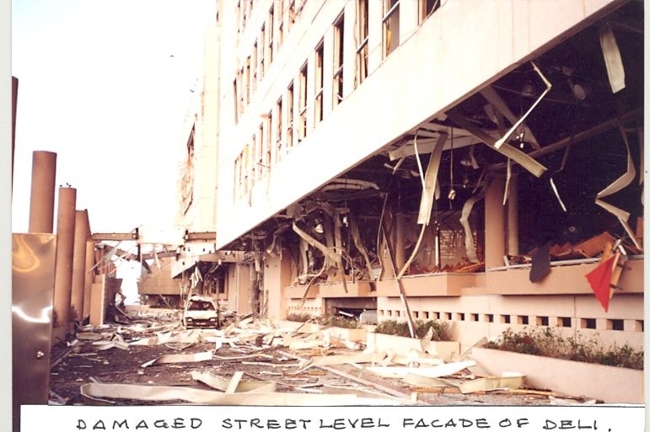
Destruction after LTTE Bomb
World Trade Center today

Slide 8
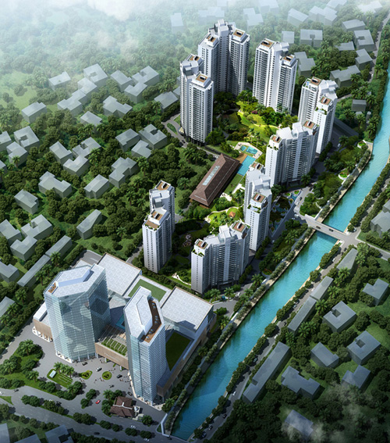
HAVELOCK CITY
Sri Lanka’s largest mixed development
18 acres of freehold land
8 Residential towers (1,080 apartments)
Clubhouse
Commercial development
Sri Lanka’s largest Mall
Office Towers

Slide 9
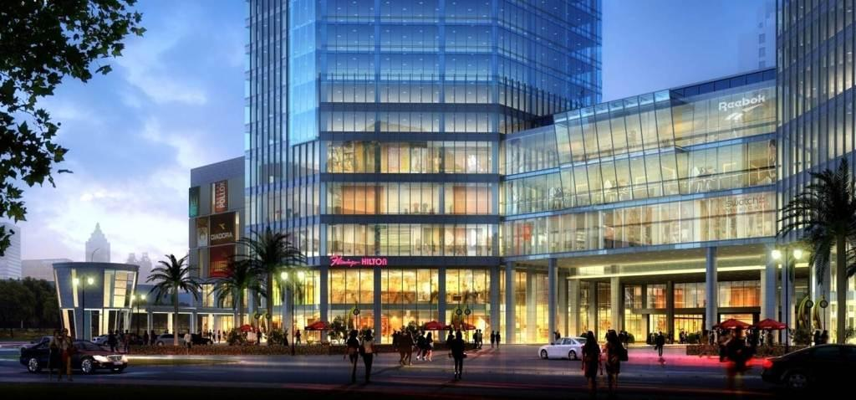
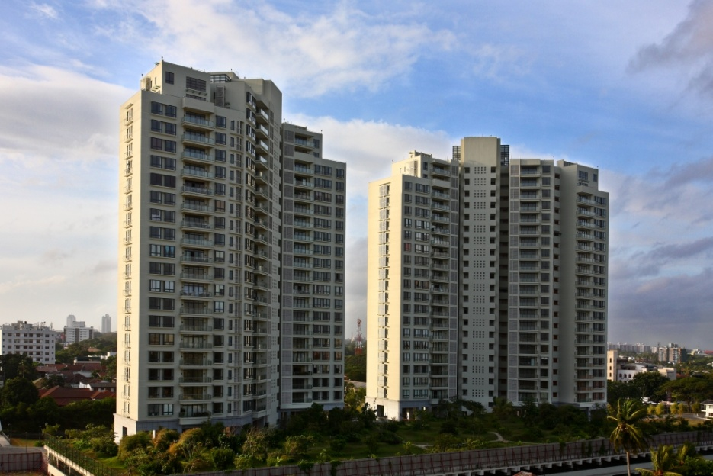
Havelock City Commercial Complex
Park & Elibank Towers
Clubhouse with modern facilities

